Slide 1
System Identification II
Recap and Examples
Notes:
Bioen485 Computational Bioengineering
10/26/2004
Closed vs open loop; partition analysis; glucose-insulin regulation; Minimal Modeling

Slide 2
Recap of System Identification
Determine a possible model
  use knowledge of mechanism, or appearance of data
  Simpler is better because:
  Must have more data than unknown parameters
Assume an error model
  use knowledge of mechanism, or appearance of data
Get initial guesses for the unknown parameters
Minimize the objective function, J (see next slide)
  sum of squares of residuals weighted by the error model
Now have: Parameters, weighted residuals, and J

Slide 3
Weighting Schemes: σ is:
Constant coefficient of variation (CV)
  error in the data = constant percent = CV% of the data value
  σ is proportional to to measurement or model value
Constant standard deviation (SD)
  error in the data = constant = SD
  σ is independent of size of measurement and model
General Variance Model
  error in the data = f[A+Bf(b)C]
    function of the model prediction
    A, B and C are constants
Notes:
Bioen485 Computational Bioengineering
10/26/2004
Closed vs open loop; partition analysis; glucose-insulin regulation; Minimal Modeling

Slide 4
Using MATLAB’s fminsearch
guess parameters
fminsearch
starts with p = guesses.
calls userOBJ(p) to get J(p)
iterates to find ∂J/∂p and move along gradient until at minimum.
returns p as ‘estimates’ and J.
[estimates,J] = fminsearch(@obj,guesses)
iteratively calls
function J = userOBJ(guesses)
userOBJ defined by user:
calls odesolver, which calls userODE to calculate model.
calculate y(i,p) from model
calculates J from model y(i,p), data z(i), and error model w(i).
iteratively calls
function dydt = userODE(t,y,p)

Slide 5
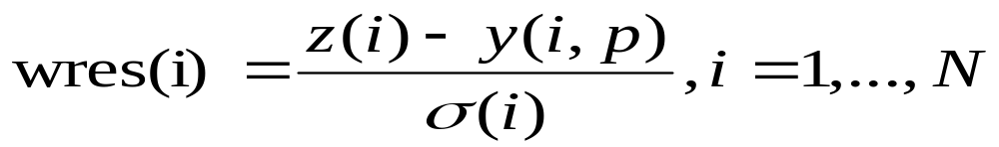
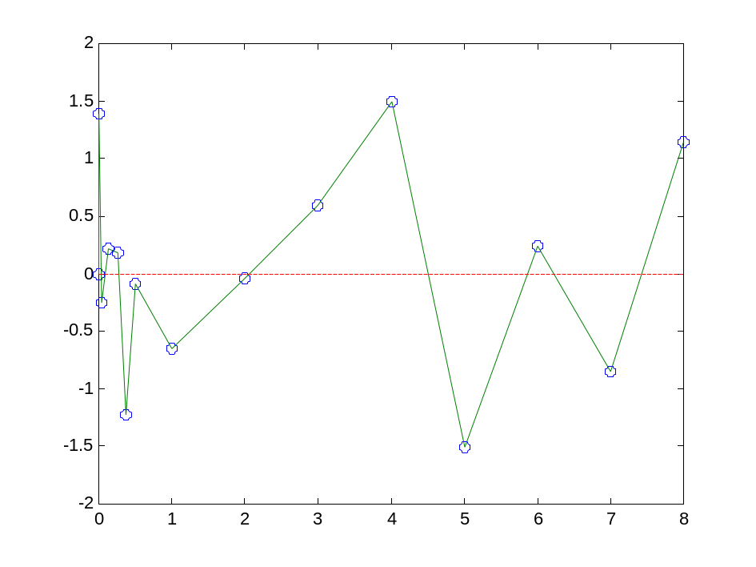
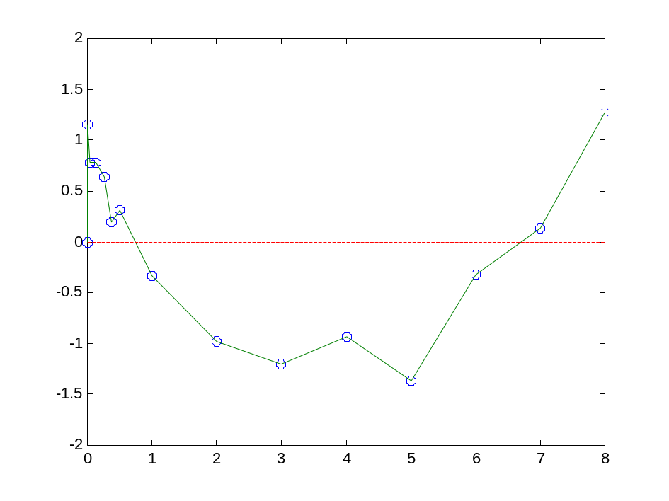
Determining Weights: Goodness of Fit
Weighted residuals reflects the hypotheses about measurement error statistics. Check: are the weighted residuals normally distributed and independent?
Weighted residual
Weighted residual
System value (y or z)
time
OK - normal distributed,
independent of value
No – weighted residuals are not independent
Notes:
Bioen485 Computational Bioengineering
10/26/2004
Closed vs open loop; partition analysis; glucose-insulin regulation; Minimal Modeling

Slide 6
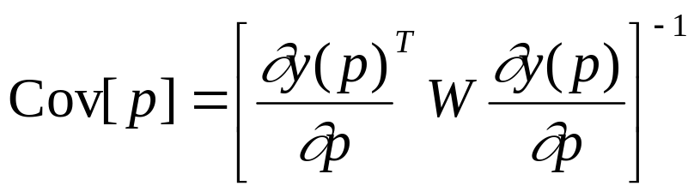
Parameter Precisions
(often called Standard Errors)
Y is the vector of model value for each data point given the parameters (length = N)
p are the parameters (length = M)
Remember the notation: ∂y/∂p is the Jacobian again. This time it is how the model values vary as the parameters change. (N by M, so transpose is M x N)
W is a diagonal matrix of the vector of weights. (N x N)
Thus Cov(p) is a M x M matrix
So this reflects how the model behavior is sensitive to variation in each parameter (diagonals) and in pairs of parameters (rest).
Is accurate only if the weights reflect measurement error
The precisions are a function of the richness of the experiment/model
Notes:
Bioen485 Computational Bioengineering
10/26/2004
Closed vs open loop; partition analysis; glucose-insulin regulation; Minimal Modeling

Slide 7
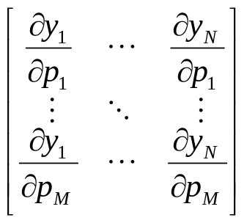
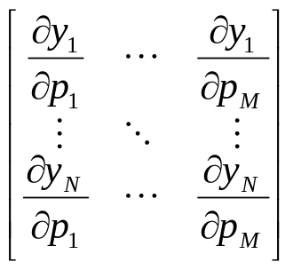
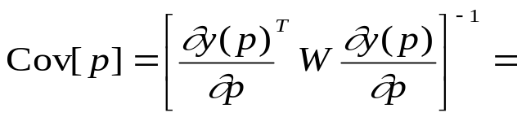
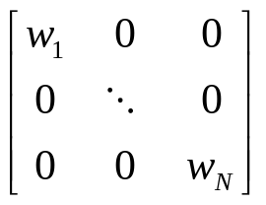
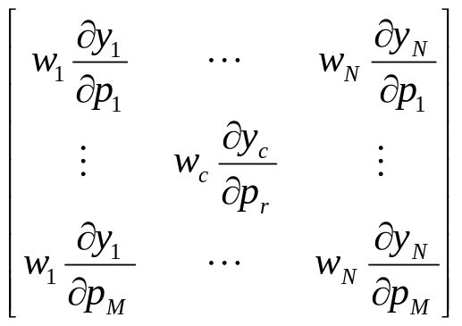
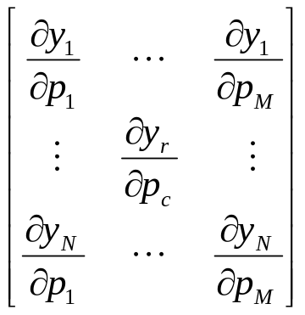
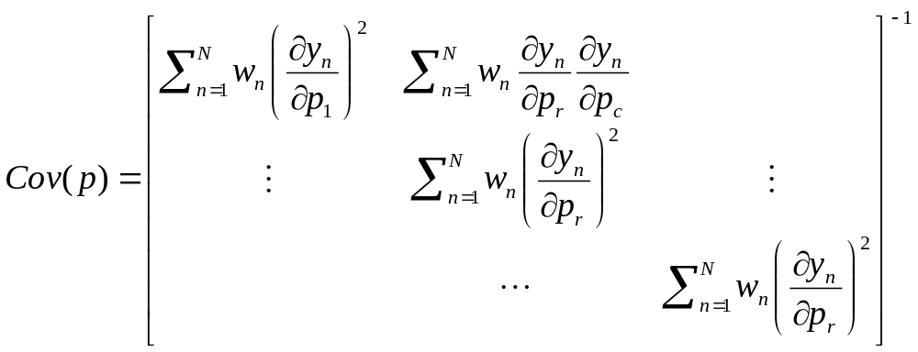
Parameter Precisions
(
)
-1
(MxN)(NxN)(NxM)
(
)
-1
(Mx1)(NxM)
(MxM)
mth diagonal value is the weighted sum of the squares of how each data prediction varies with the parameter m
Notes:
Bioen485 Computational Bioengineering
10/26/2004
Closed vs open loop; partition analysis; glucose-insulin regulation; Minimal Modeling

Slide 8
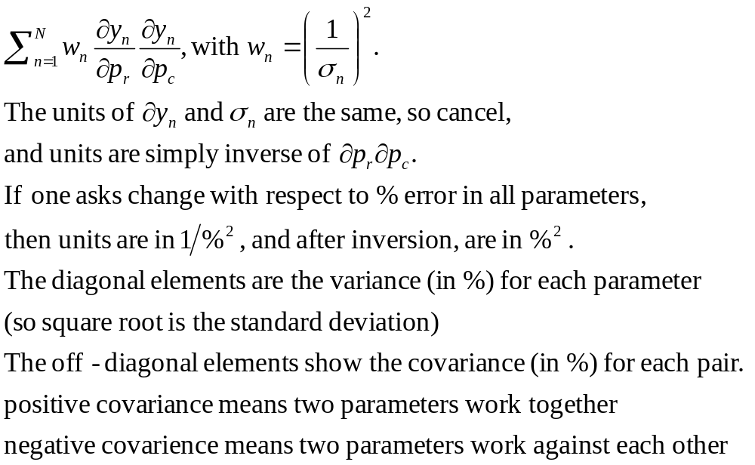
Units in Parameter Precisions
Consider individual terms in the matrix prior to inverting:
Notes:
Bioen485 Computational Bioengineering
10/26/2004
Closed vs open loop; partition analysis; glucose-insulin regulation; Minimal Modeling

Slide 9
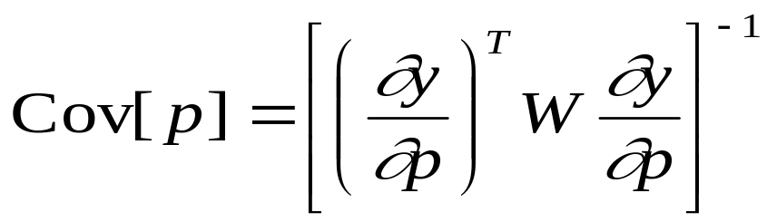
Parameter Precisions
In MATLAB
You don’t have an analytic expression for the Jacobian, since you don’t have an equation for y(p) in general.
But, you can calculate it numerically
  Calculate the y vector (recall this is the model prediction that corresponds to each data point, at the final parameter values p.
    typically a subset of the variables at a discrete set of time points.
    Put these all in a single vector, even if they include more than one variable.
  Increase one parameter a tiny amount (0.1%?) and recalculate the y-vector. Calculate (ynew-y(p))/0.1% to get the derivative.
    You have the first column of the Jacobian, delydelp.
    Repeat for each other parameter, keeping all the rest at the original p values.
  Calculate the diagonal matrix W from the weighting scheme.
  Perform matrix multiplication and invert the result
  Consider the diagonal elements to get parameters precisions.
  Check your units!
Notes:
Bioen485 Computational Bioengineering
10/26/2004
Closed vs open loop; partition analysis; glucose-insulin regulation; Minimal Modeling

Slide 10
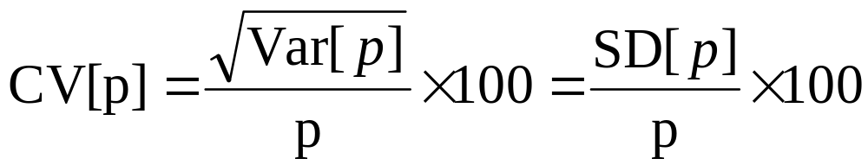
Normalized Parameter Precisions
Essentially, this says how much each parameter can vary and not affect the model beyond the assumed errors in the data.
Usually they are also called %CV (percent coefficient of variation) or %FSD (fractional standard deviations)
Bad precisions (CV>100%) are often a symptom of a model that is too complex, i.e. has too much detail to be resolvable.
Often, a model will result in bad precisions on one or a few parameters only, meaning they are not well resolved by the model.

Slide 11
Comparing Models
Now have: Parameters, weighted residuals, and J
Try different guesses for parameters
  May get same P, wres, J or different due to local mins
  If different, go with P and wres that make lower J.
Try different error/statistical models
  Better model has more uniformly distributed wres.
  Cannot use J to compare error models!
Try different system models. If same # params and same error model, then…
  Better model has more uniformly distributed wres, and lower J
Notes:
Bioen485 Computational Bioengineering
10/26/2004
Closed vs open loop; partition analysis; glucose-insulin regulation; Minimal Modeling

Slide 12
Comparing Models of Different Complexity
If different numbers of parameters:
  If more parameters does not improve J or uniformity of wres, clearly not better
  But how much better does J need to be to warrant the more complex model?
Various criteria can be used to weight the number of parameters.
  Beyond the scope of this class but you can read more..
    Akaike information criterion (AIC)
    Bayesian information criterion (BIC)

Slide 13
Example 1:
Surface Plasmon Resonance (SPR)
Receptor on gold Surface
Analyte flows through
SPR signal reflects mass of material on surface, so change in SPR reflects binding.
Error is constant, since ligand and receptor are only small part of mass on surface.

Slide 14
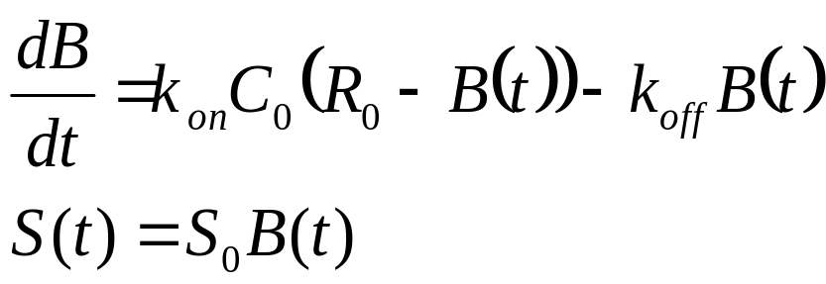
SPR Example: Equations
Variables:
  B(t)= surface concentration of Bound complex
  S(t) = signal read by SPR
Parameters:
  C₀ = Solution concentration of Analyte (assume constant)
  R₀ = Total surface concentration of Receptor
  S₀ = sensitivity of SPR to receptor binding
Equation:

Slide 15
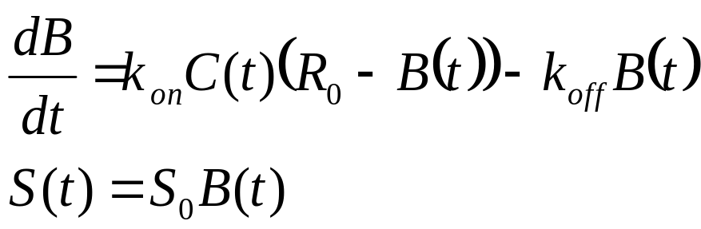
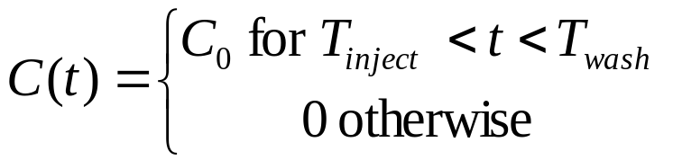
Input for SPR:
Concentration of analyte is a time-dependent parameter, C(t):
Injection followed by wash:
  At time T_{inject}, C(t) jumps from 0 to C₀.
  At time T_{wash}, C(t) jumps from C₀ to 0.

Slide 16
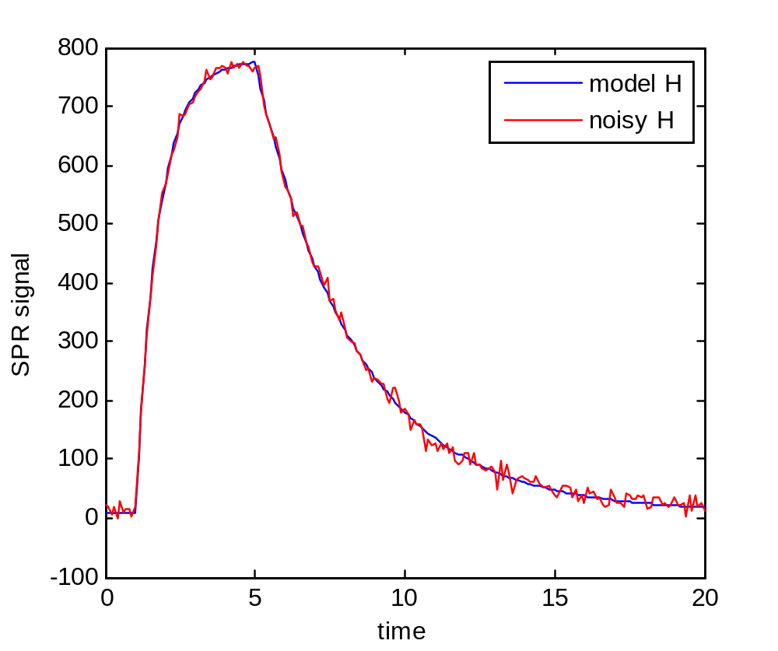
Simulate SPR:
model
model+noise

Slide 17
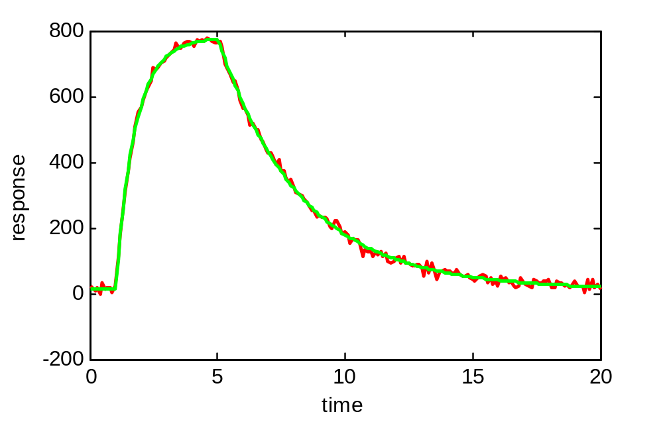
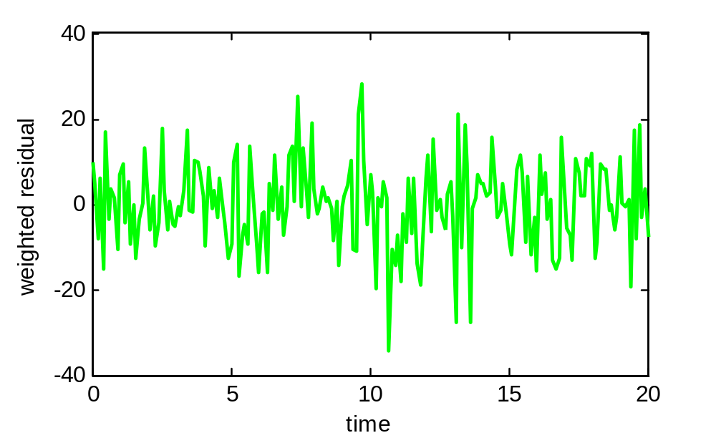
Fit model to data, constant SD:
Parameter estimates:
 | k_{on}S₀ | k_{off}
used | .1 | 0.3
Est. | .099 | 0.307
error | 0.7% | -2.2%

Slide 18
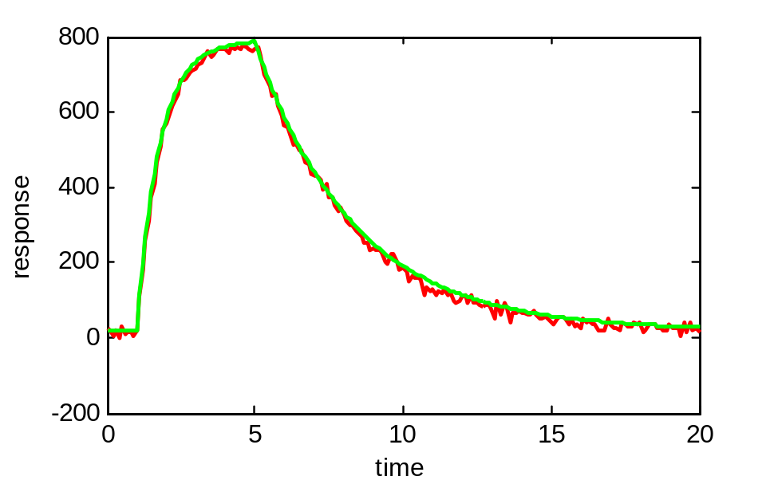
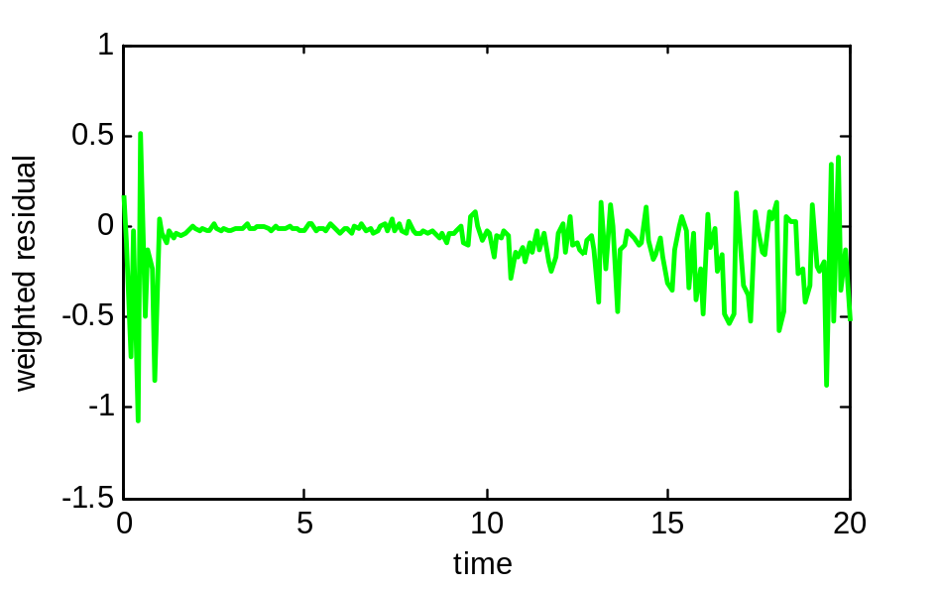
Fit model to data, constant CV:
Parameter estimates:
 | k_{on}S₀ | k_{off}
used | 0.1 | 0.3
Est. | 0.098 | 0.322
error | 1.9% | 7.4%

Slide 19
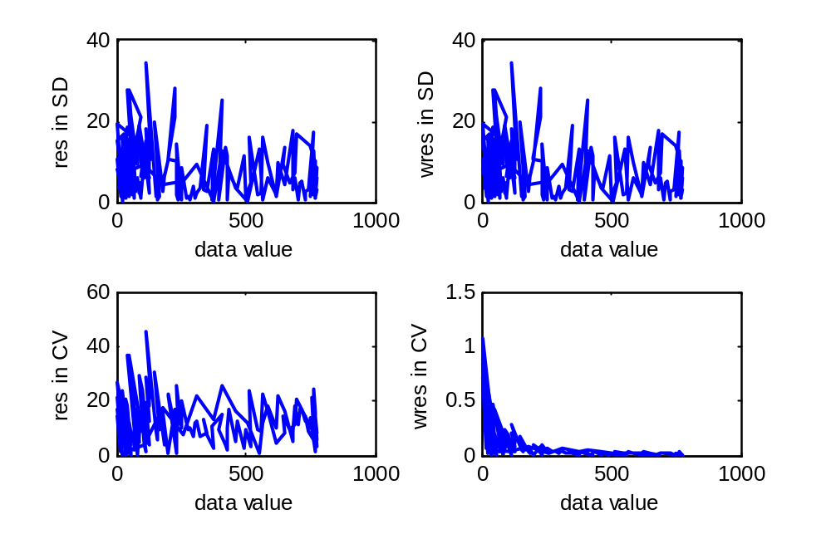
Evaluate Error Model:
Plot the residuals against data value:
Plot the weighted residuals against data value:
SD: assumed
error constant
CV: assumed
error proportional
Compare to assumptions

Slide 20
How to use Objective Function (J)?
Different Guesses:
Often get different estimates due to local minima
How to decide which is better?
The lower Objective Function
Different models or weighting schemes:
Cannot, in general, compare Objective Functions to pick best.
Why not?
Scale Factor affects J and scale of the weighted residuals,
but not the parameters, the evaluation of residuals, or the fit.

Slide 21
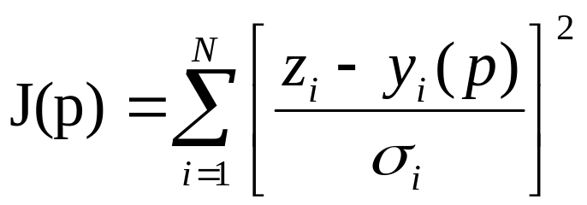
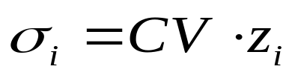
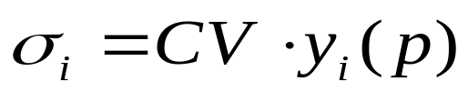
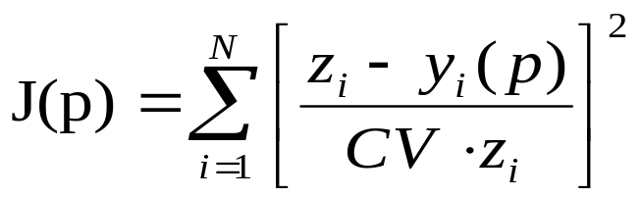
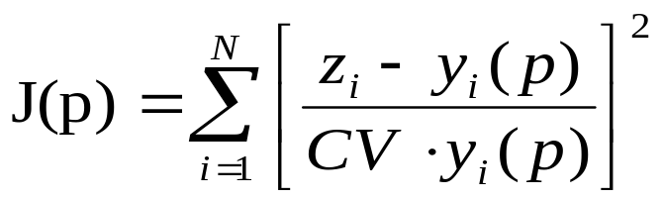
Error Modeling Issues:
Recall:
For CV, (% error is important; error scales with the value)
Use data value?
Use model value?
Dividing by model risks biasing to parameters that increase the model value, rather than decrease the difference.
Dividing by data is more stable.
But, if we have a zero or near-zero value for the data, this can be unstable.

Slide 22
Why don’t we use the standard deviation or SEM of the measurements?
The standard deviations are only an estimate of the error
The fewer the points, the worse the estimate
If two duplicates happen to be very close, the standard deviation undertstates the error at this data value, and the model is too constrained to this point.

Slide 23
Is the Problem Well-Determined?
Do you have enough of the right type of data to determine the parameters?
If not:
Sample more compartments?
Simplify model? (combined parameters?)
Create alternate experiment to independently determine a subset of the problem

Slide 24
SPR identifiability:
Usually don’t know receptor concentration R₀ or response scaling, S₀.
But C₀ is known.
So 4 unknowns:
  k_{on}
  k_{off}
  R₀
  S₀
  However, the complexity of our data only justifies three parameters. (rate of approach, rate of decay, and steady state value. If time is too short to estimate steady state, then only two parameters: rate of increase and rate of decay.
  To fix this, must run multiple concentrations.

Slide 25
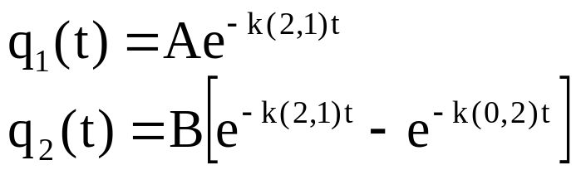

Model Identifiability Properties
(Must Be Assessed Before Estimation)
Input
Measurement
Input
Measurement
Measurement
1
k(2,1)
2
k(2,1)
1
2
k(0,2)
?
k(0,2)
Not identifiable
Identifiable
Notes:
Bioen485 Computational Bioengineering
10/21/2004
The inverse problem: System Identification; Parameter estimation; Deconvolution

Slide 26
Model Identifiability Properties
(Sometimes Unexpected)
Input
Measurement
Input
Measurement
1
k(2,1)
2
k(2,1)
1
2
k(0,2)
?
k(0,2)
Not identifiable
Identifiable, but not uniquely!
Notes:
Bioen485 Computational Bioengineering
10/21/2004
The inverse problem: System Identification; Parameter estimation; Deconvolution

Slide 27
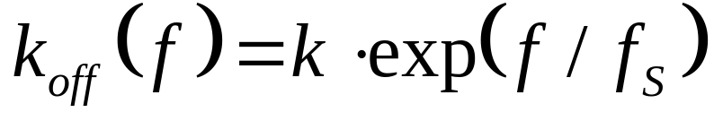
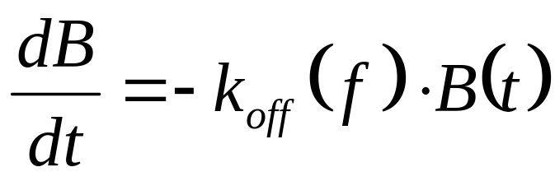
Lab Example: bond strength under force
Simplest model for a bond:
Compartmental 1-state model
Unbinding rate = k_{off} is a function of force.
B(t) = number of bonds still formed at time t.
Simple ODE:
bound
k_{off}(f)
unbound

Slide 28
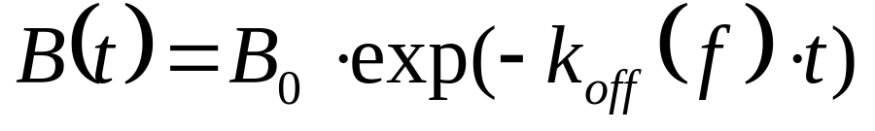
constant force
At constant force, linear ODE with solution:
B0 is the number of bonds at the start. Note that bonds are not all there at once – each is tested one at a time, but then we look at all data together. So B(t) means how many bonds are left at time t after the test for each bond starts.
The rate of exponential decay depends on the force.

Slide 29
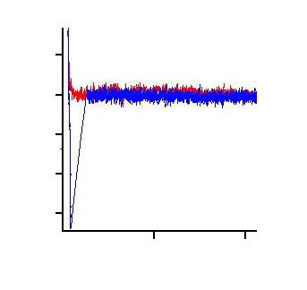
Atomic Force Microscope (AFM)
We use the AFM to “feel” adhesive forces.
photodiode
detector
repulsion
(push)
laser light
50
0
-50
-100
-150
-200
-250
approach
retract
receptor cantilever tip
(~ 20 nm across)
Force, pN
attraction
(pull)
rupture force
Ligand-coated surface
0 0.2
Separation, μm
Method of single molecule force spectroscopy

Slide 30
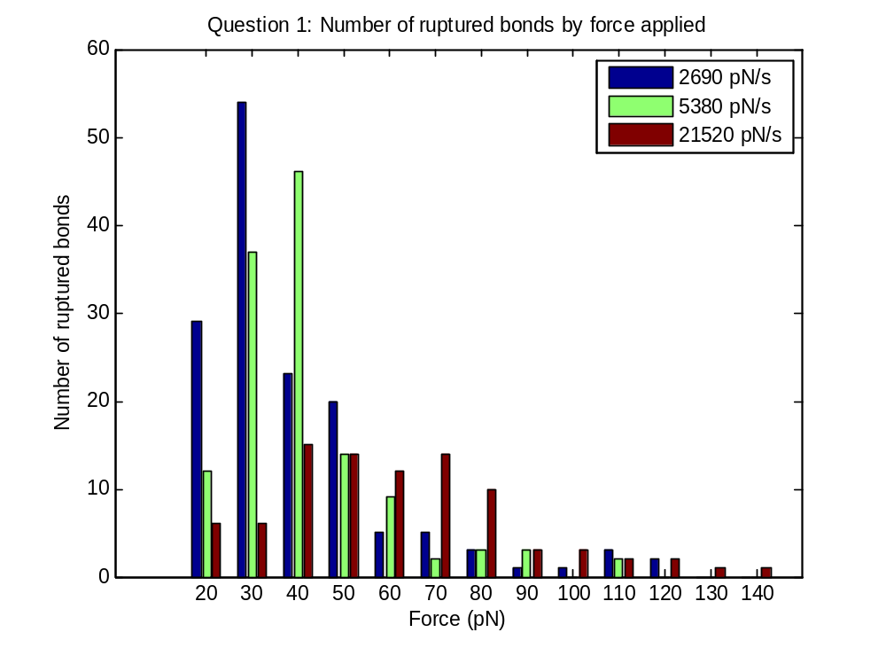
Data: Histogram of Bond Rupture Forces in AFM for von Willebrand – GPIb bond

Slide 31
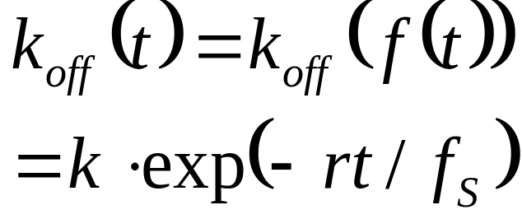
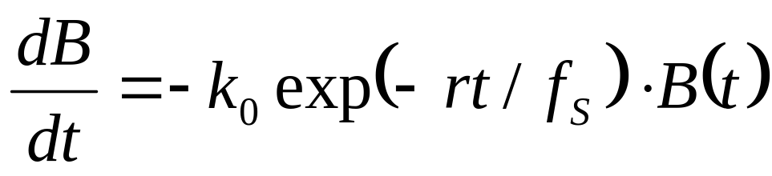
force increases with time
f(t) = rt, where r is loading rate
ODE is:
IC B(0)

Slide 32
Comparing Model to Data:
Data shows number of bond ruptures as function of force
Model gives number of bonds remaining as a function of time.
Switch time in model to force with f = rt.
Experimentalist bin the data (eg, cutoffs at 20, 30, 40,.. 140 pN). Number of ruptures in bin is difference between bonds remaining at F(i) vs previous point, F(i-1).
Also: have three loading rates, r, so have three ODEs.

Slide 33
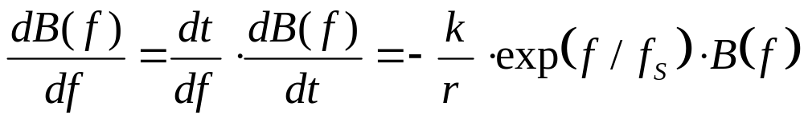
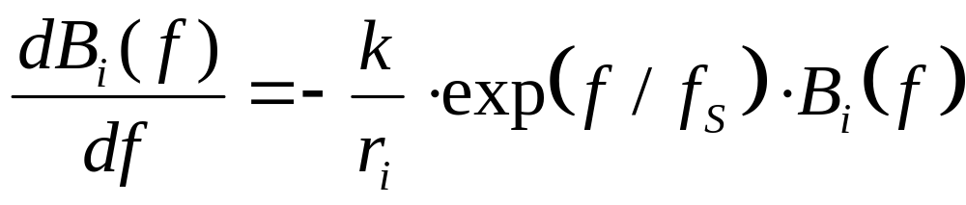
Match model to data
ODE is:
Change to ODE in force
have 3 ODEs:

Slide 34
Parameters
Parameters to be fit
The amount of force needed to increase rupture rate, f_{S}
The rupture rate without force, k
The initial numbers of bonds in each conditions (B1(0), B2(0), B3(0). Sum of ruptures includes some nonspecific bonds, and misses some that broke before 10 pN)
Known parameters:
The three loading rates: r₁, r₂, r₃.
Need to fit f_{S} and k for all three conditions simultaneously, since they relate to the bond properties, which are the same regardless of loading rate.
Notes:
Bioen485 Computational Bioengineering
10/26/2004
Closed vs open loop; partition analysis; glucose-insulin regulation; Minimal Modeling

